Slide 1
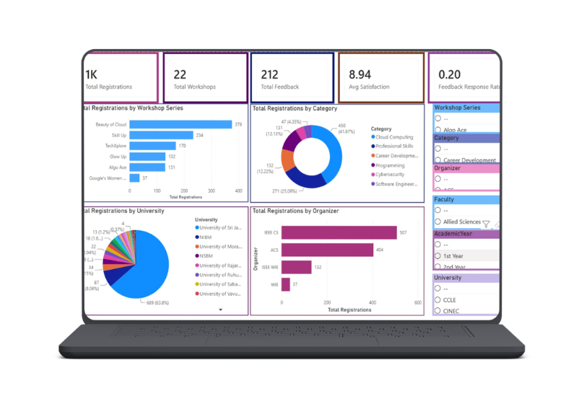

GROUP 06
Academic Workshop Participation & Engagement Analysis
CIS3062 – Business Intelligence
By Group 06
FC223007-W.R.U.T.D. Wijayasundara
FC223027-P.S.D.K.Fernando
FC223021-G.K.Krishmanthi
FC223025-W.T.M. Silva
FC223005-A.N.M.H.W. Nawarathna
FC223026-R.S. Muthumali

Slide 2

PROJECT OVERVIEW
Workshops improve technical + professional skills
Topics: AI, Cloud, Cybersecurity, Programming, etc.
Data scattered across forms and spreadsheets
Hard to analyze participation manually
BI converts raw data into insights using dashboards
PROBLEM STATEMENT
Workshop data stored in separate systems
No centralized analysis of participation or feedback
Difficult to identify:
○ Popular workshops
○ Engagement level
○ Effective organizers
Decisions based on assumptions, not data

Slide 3
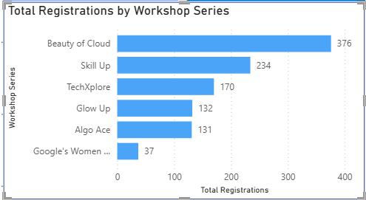
GROUP 06
OBJECTIVES
Main Objective
Build BI dashboard to analyze workshop participation and engagement
Specific Objectives
Compare workshop participation
Identify popular categories
Analyze faculty and academic year trends
Study feedback and satisfaction
Support future planning decisions

Slide 4



GROUP 06
METHODOLOGY & DATA MODEL
Methodology Overview
Data collected from:
Registration forms
Feedback forms
Tools used:
Google Forms
Excel (cleaning & preparation)
Power BI (analysis & dashboard)
Data Model
Star schema design in Power BI
Fact tables:
Registration_Data
Feedback_Data
Dimension tables:
Workshop, Faculty, University, Academic Year, Category
Key ID: WorkshopID

Slide 5
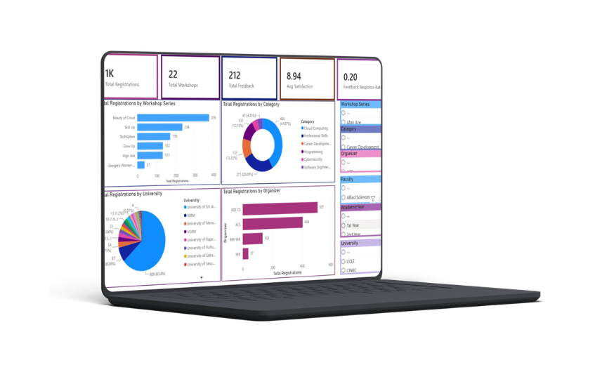
GROUP 06
DASHBOARD OVERVIEW
Built using Power BI
4 main pages:
○ Executive Overview
○ Participant Analysis
○ Workshop Performance
○ Feedback Analysis
Interactive filters (faculty, category, year, etc.)
KEY FINDINGS
1,080 registrations across 22 workshops
212 feedback responses (20%)
Average satisfaction: 8.94 / 10
Strong engagement overall
Cloud Computing most popular area

Slide 6

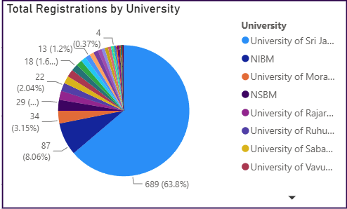
GROUP 06
PARTICIPATION INSIGHTS
Highest workshop series: Beauty of Cloud
Most active faculty: Computing
Most active year: 2nd year students
USJ dominates participation (63.8%)
External universities also involved
Campaign Performance Highlights

Slide 7
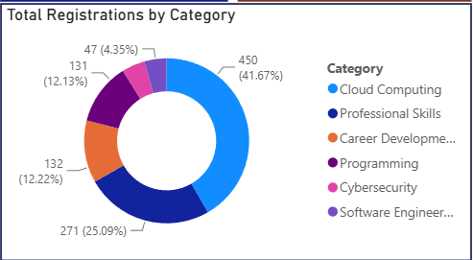
GROUP 06
BUSINESS INSIGHTS
Cloud Computing = highest demand
IEEE CS = strongest organizer
Feedback rate is low (20%)
High satisfaction overall
Participation uneven across faculties
Expand Cloud + Professional Skills workshops
Increase participation from other faculties
Improve feedback response (QR, email, incentives)
Strengthen external university collaboration
Share best practices from IEEE CS
RECOMMENDATIONS

Slide 8
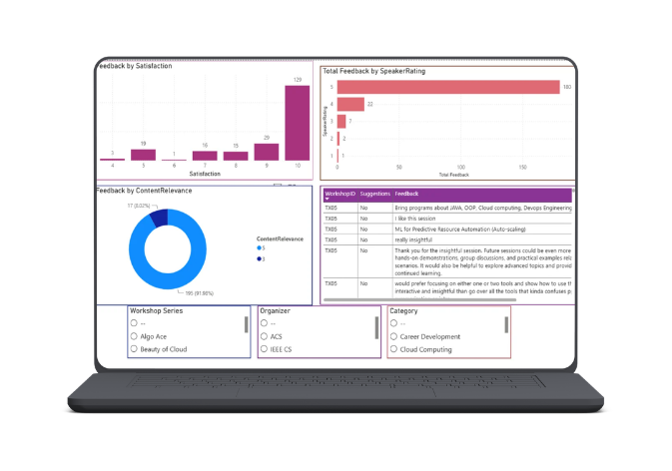
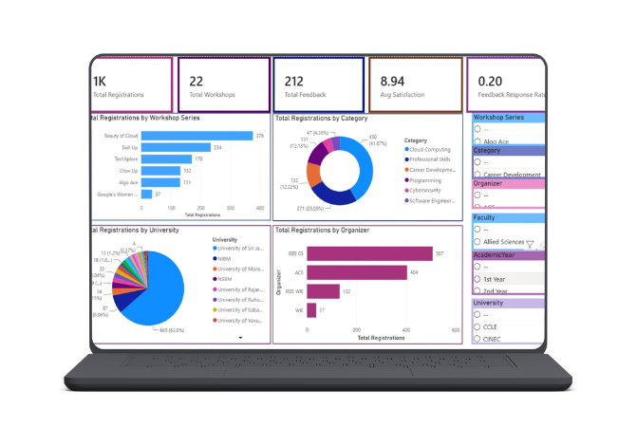
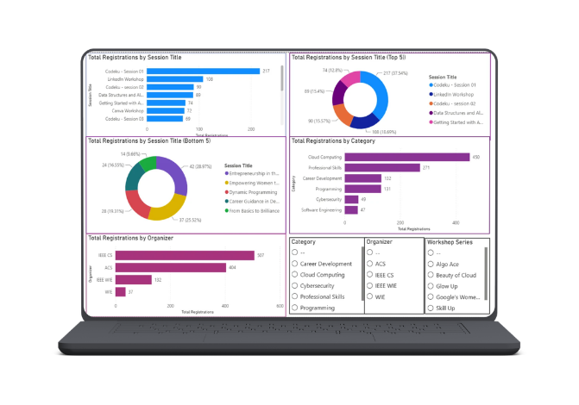
GROUP 06
CONCLUSION
BI dashboard successfully built
Converts raw data into insights
Supports data-driven decision making
Improves workshop planning
Future work - more years + predictive analysis

Slide 9
GROUP 06
Q & A

Slide 10
GROUP 06
THANK YOU !

